Slide 1


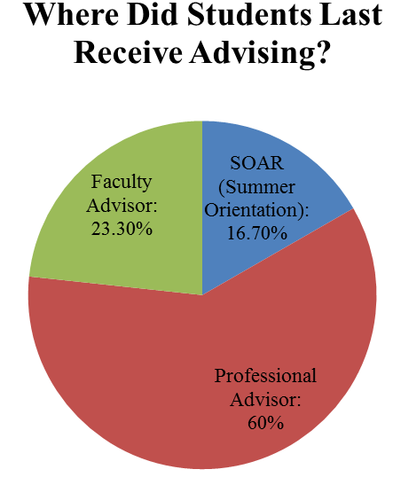
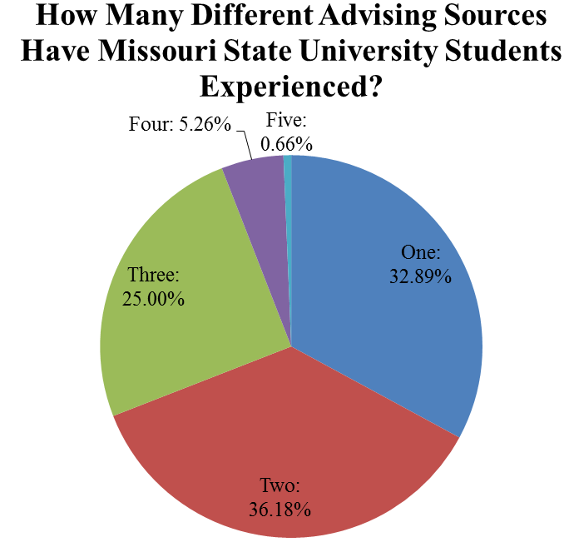
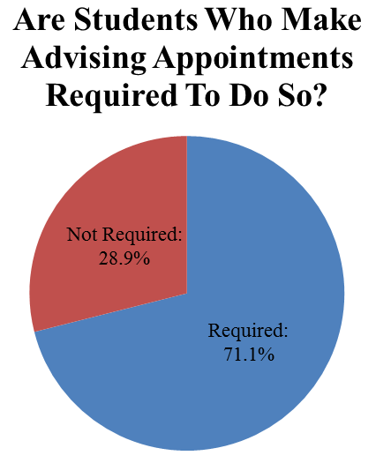
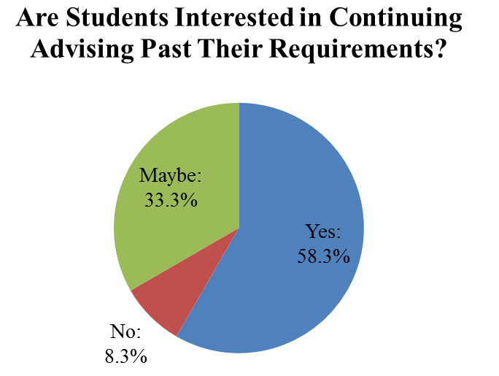
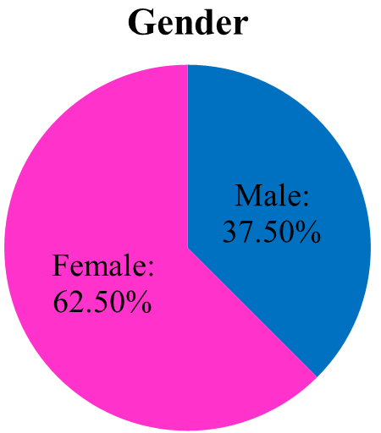
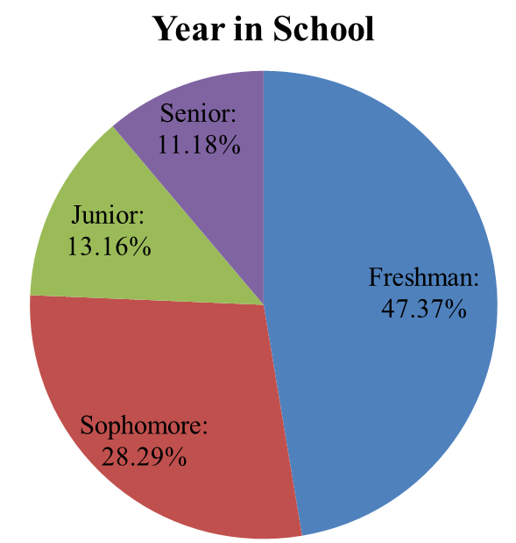
Capturing the Student Perspective: Advising at Missouri State University
Marilee L. Teasley & Dr. Erin M. Buchanan, Department of Psychology
Abstract
When students leave their advising appointments, how do they feel? Excited for what lies ahead of them? Intimidated? Frustrated? Disappointed?
If advisors and students are not on the same page about expectations and goals, the student may have a negative advising experience. An effective advisor could mean the difference between a frustrated drop-out and a successful graduate. Aiming to see how current students feel about their advising experience thus far in their collegiate career, we surveyed students at Missouri State University.
The main purpose of this study is to present a picture of how our students feel about their advising experience in three categories: prescriptive functions, developmental functions, and advisor traits. Additionally, we will discuss perceptions of students at all levels (freshmen to seniors) about the different types of advisors students work with. Finally, future research and implications will be addressed.
Advising Options Used By Students
Ratings by Advisor Type
Hypotheses
Descriptive Statistics: We examined the nature of advising at Missouri State, along with the reasons that students returned to advising after requirements were lifted.
Hypothesis #1: We believe students will rank their satisfaction of prescriptive functions higher than developmental functions. Both prescriptive functions and developmental functions will have higher ratings than overall advisor traits.
Hypothesis #2: Overall satisfaction ratings will differ based on what type of advisor (professional or faculty) a student last met with. We expect professional academic advisors to have better overall ratings than faculty advisors.
Commonly Used Sources:
Professional Advisors:
General Advisors
Department Specific Advisors
Faculty/Staff:
Faculty Members
Other Sources:
Summer Orientation (SOAR)
Peers/Friends
Results and Discussion
A mixed factorial ANOVA was analyzed to test Hypothesis 1 and 2 examining rating type, advisor type, and their interaction.
Rating type main effect (with post hoc):
Advisor traits > prescriptive functions > developmental functions
Advisor type:
Faculty = Professional Advisors on ratings
Interaction:
No significant interaction, but a trend toward lower faculty ratings
Mandatory vs. Voluntary Advising
The Advising Survey
Reasons for Continued Advising:
Graduation Requirements:
“Wanting to make sure I do not get off track.”
“…to graduate at a decent time.”
“I am trying to graduate in three years instead of four…”
Post-Graduation:
“I like to build a good relationship with my advisors for recommendations.”
“To generally make sure I’m on the right track for Pharmacy school.”
General Discussion
Questionnaire:
Demographic Information
Age, Gender, Ethnicity
Student Information
Year in School, Major
Advising Experience
Advisor Type, Requirements
Overall Advising Satisfaction
Likert Scale 1 = strongly disagree, 4 = neutral, 7 = strongly agree
Satisfaction Categories:
Prescriptive Functions: “My advisor is knowledgeable about course offerings and graduation requirements.”
Developmental Functions: “My advisor helps me connect with campus resources.”
General Advisor Traits: “I can trust my advisor.”
Participants:
Overall, students are positive about their advising experience.
Students rated general advising traits higher than prescriptive functions and developmental functions.
When asked if their advisor makes Missouri State University’s public affairs mission an important topic in advising sessions, fifty-four participants (56.3%) marked a 4 (neutral) or less.
A larger sample size may have pointed to significant differences between the various advisor types.
Studies with larger sample sizes could investigate differences in satisfaction ratings between different majors.
Further studies should compare student expectations to actual experience in advising sessions.
More scales related to academic advising should be developed and researched.
Reasons Not To Continue Advising:
Not Worth The Time:
“I am aware of the courses I need, and I do not need the advisor’s input.”
“I prefer to take care of things myself, in my own time.”
“They tell you everything that has been explained to me many times before.”
It’s Frustrating:
“It frustrates me that I have to wait to sign up for classes.”
“…it is a bit of a hassle…”
“My advisor just releases me for my classes.”
References
Allen, J. M., & Smith, C. L. (2008). Faculty and student perspectives on advising: Implications for student dissatisfaction. Journal of College Student Development, 49(6), 609-624.
Creamer, D. G., & Creamer, E. G. (1994). Practicing developmental advising: Theoretical contexts and functional applications. NACADA Journal, 14(2), 17-24.
Crookston, B. B. (1972). A developmental view of academic advising as teaching. Journal of College Student Personnel, 13, 12-17.
Fielstein, L. L. (1994). Developmental versus prescriptive advising: Must it be one or the other? NACADA Journal, 14(2), 76-79.
O’Banion, T. (1972). An academic advising model. Junior College Journal, 42, 62, 64, 66-69. (reprinted in NACADA Journal, 14(2), 10-16).

